Slide 1
authentic work of god
church builders workshop

Slide 2
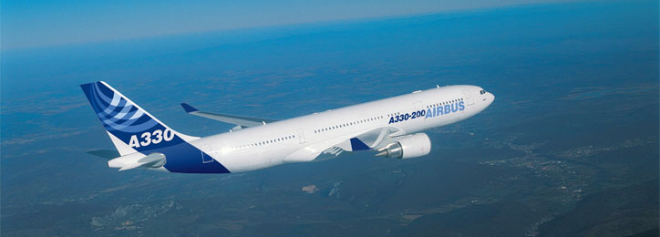
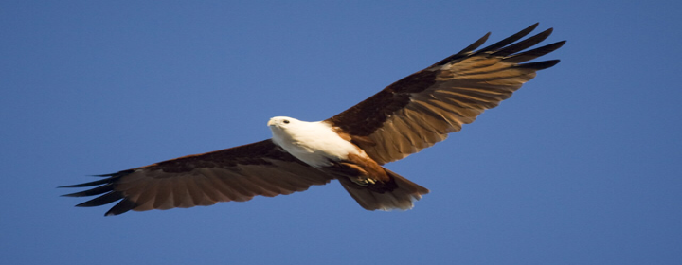

Slide 3
a model of authentic work of god
authentic work of god
And so you became a model to all the believers in Macedonia and Achaia.
The Lord's message rang out from you not only in Macedonia and Achaia--your faith in God has become known everywhere. Therefore we do not need to say anything about it,
1 Thessalonians 1:7-8

Slide 4
thessalonica
Corinth
Ephesus

Slide 6
faith that withstands
authentic work of god
You became imitators of us and of the Lord; in spite of severe suffering, you welcomed the message with the joy given by the Holy Spirit.
1 Thes 1:6

Slide 7
what do i want to see?
authentic work of god

Slide 8
what do i want to see?
authentic work of god
What kind of ministry will produce this kind of person?
What kind of church will produce this kind of fruit?

Slide 9
THE MESSENGER
THE MESSAGE

Slide 10
the message
authentic work of god
because our gospel came to you not simply with words, but also with power, with the Holy Spirit and with deep conviction. You know how we lived among you for your sake.
1 Thes 1:5

Slide 11
the message
authentic work of god
and to wait for his Son from heaven, whom he raised from the dead--Jesus, who rescues us from the coming wrath.
1 Thes 1:10

Slide 12
THE MESSENGER
THE MESSAGE

Slide 13
THE MESSENGER
THE MESSAGE

Slide 14
the MESSENGER
authentic work of god
because our gospel came to you not simply with words, but also with power, with the Holy Spirit and with deep conviction. You know how we lived among you for your sake.
1 Thes 1:5

Slide 16
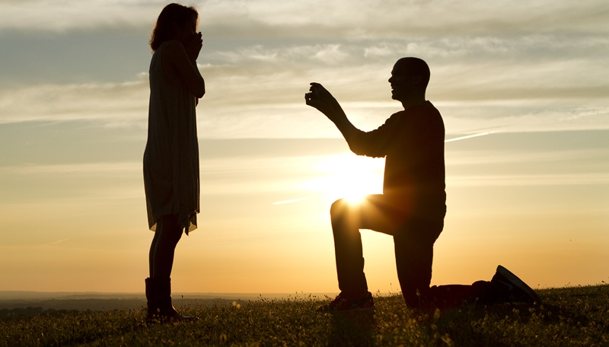

Slide 17
THE receiver
THE MESSAGE

Slide 18
what kind of christian are we producing?
authentic work of god
You became imitators of us and of the Lord; in spite of severe suffering, you welcomed the message with the joy given by the Holy Spirit.
1 Thes 1:6

Slide 19
YOU BECOME IMITATORS OF US
authentic work of god
the kind of christian who will be the fruit of your ministry will be the reflection of christian that you already are
THE KIND OF MINISTRY WE OFFER WILL SHAPE THE KIND OF CHRISTIAN WE BECOME. AND THE KIND OF CHIRSTIAN WE BECOME WILL SHAPE THE KIND OF CHRISTIAN WE PRODUCE.
THINK OF THE LIFE YOU ARE LIVING AND THE RELATIONSHIP THAT YOU ARE INFLUENCING

Slide 20
what are the mark of this authentic work of god?
authentic work of god
1 Thessalonians 1:2-3
We always thank God for all of you, mentioning you in our prayers.
We continually remember before our God and Father your work produced by faith, your labor prompted by love, and your endurance inspired by hope in our Lord Jesus Christ.
1 Thessalonians 1:9-10
for they themselves report what kind of reception you gave us. They tell how you turned to God from idols to serve the living and true God,
and to wait for his Son from heaven, whom he raised from the dead--Jesus, who rescues us from the coming wrath.

Slide 21
the urgency
authentic work of god
1 Thessalonians 2:12
encouraging, comforting and urging you to live lives worthy of God, who calls you into his kingdom and glory.
1 Thessalonians 4:1
Finally, brothers, we instructed you how to live in order to please God, as in fact you are living. Now we ask you and urge you in the Lord Jesus to do this more and more.

Slide 22
the urgency
authentic work of god
1 Thessalonians 4:10
And in fact, you do love all the brothers throughout Macedonia. Yet we urge you, brothers, to do so more and more.
1 Thessalonians 5:14
And we urge you, brothers, warn those who are idle, encourage the timid, help the weak, be patient with everyone.

Slide 23
BELIEVE
BELONG
BECOME

Slide 24
BELIEVE
BELONG
BECOME

Slide 25
Conversion Growth
Assimilation
Group Multiplication
Pray
Reach
Care
Empower
Mentor
Equip

Slide 26
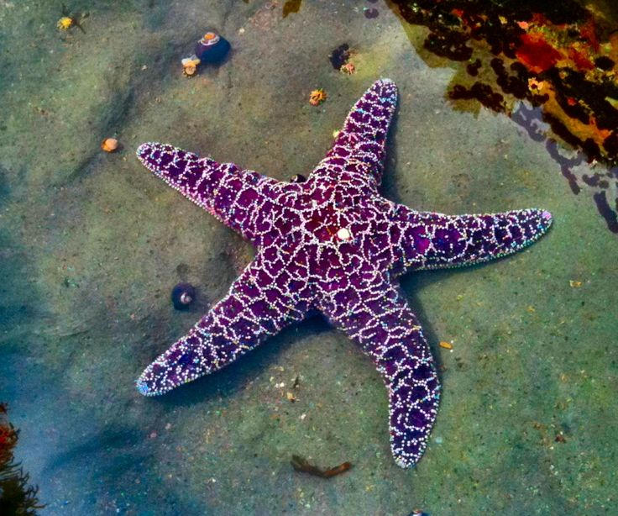

Slide 27
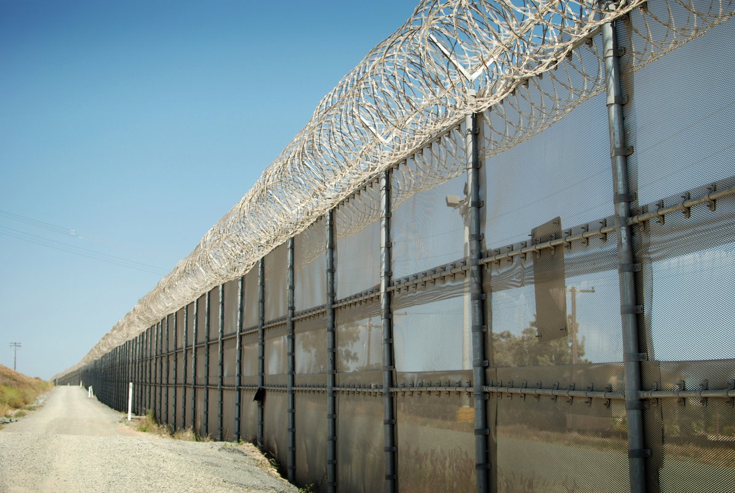
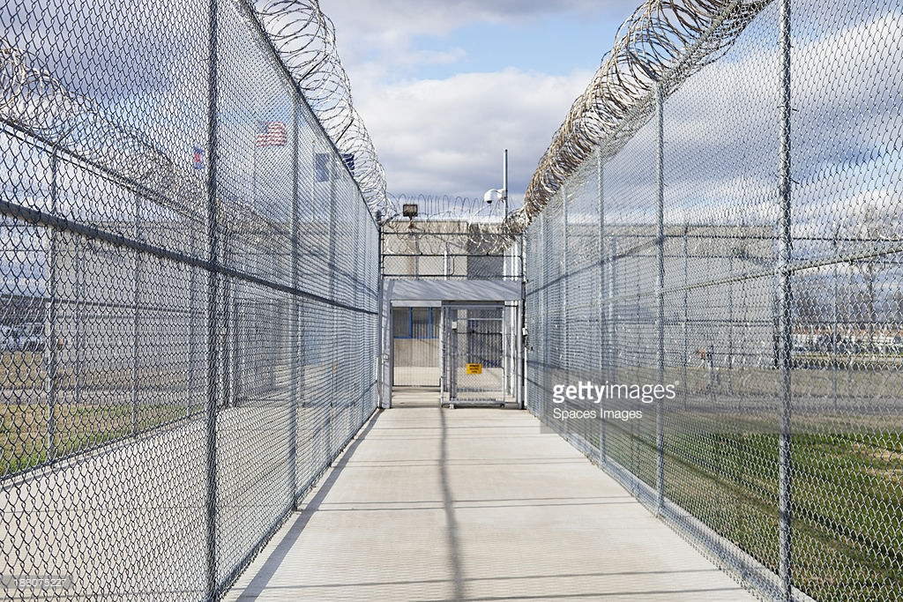

Slide 28
F.R.A.N GELISM
authentic work of god
FRIENDS
RELATIVES
ASSOCIATES
NEIGHBOURS

Slide 29
RELATIONAL EVANGELISM
4
Invitation
3
Expose to the gospel
2
Introduce to Community
1
Clear Identification
4
Friend
3
Serve
2
Better Acquainted
1
Initial Contact

Slide 30
5 “ONE ANOTHER” IN SMALL GROUP:
authentic work of god
To KNOW and to be KNOWN
To ENCOURAGE and to be ENCOURAGED
To CELEBRATE and to be CELEBRATED
To SERVE and to be SERVED
To ADMONISH and to be ADMONISHED

Slide 31
how to conduct a D-group?
authentic work of god
Setting the goal
By Group: Clarification
By Group: Give Feedback
Share what is helpful
By Group: Encouragement

Slide 32
please god not men
out of comfort zone
christlike

Slide 33
please god not men
out of comfort zone
christlike

Slide 34
FAITH STANDING FIRM
FAITH UNDER TRIALS
Notes:
Tello to set out for a definite point or goal
Raison D’être
Hebrews 13:20–21 Now may the God of peace, who through the blood of the eternal covenant brought back from the dead our Lord Jesus, that great Shepherd of the sheep, ²¹ equip you with everything good for doing his will, and may he work in us what is pleasing to him, through Jesus Christ, to whom be glory for ever and ever. Amen.
Ephesians 4:11–13 So Christ himself gave the apostles, the prophets, the evangelists, the pastors and teachers, ¹² to equip his people for works of service, so that the body of Christ may be built up ¹³ until we all reach unity in the faith and in the knowledge of the Son of God and become mature, attaining to the whole measure of the fullness of Christ.
1 Corinthians 9:24–27 Do you not know that in a race all the runners run, but only one gets the prize? Run in such a way as to get the prize. ²⁵ Everyone who competes in the games goes into strict training. They do it to get a crown that will not last, but we do it to get a crown that will last forever. ²⁶ Therefore I do not run like someone running aimlessly; I do not fight like a boxer beating the air. ²⁷ No, I strike a blow to my body and make it my slave so that after I have preached to others, I myself will not be disqualified for the prize.

Slide 35
FAITH STANDING FIRM
FAITH UNDER TRIALS
Notes:
Tello to set out for a definite point or goal
Raison D’être
Ephesians 4:11–13 So Christ himself gave the apostles, the prophets, the evangelists, the pastors and teachers, ¹² to equip his people for works of service, so that the body of Christ may be built up ¹³ until we all reach unity in the faith and in the knowledge of the Son of God and become mature, attaining to the whole measure of the fullness of Christ.
Hebrews 13:20–21 Now may the God of peace, who through the blood of the eternal covenant brought back from the dead our Lord Jesus, that great Shepherd of the sheep, ²¹ equip you with everything good for doing his will, and may he work in us what is pleasing to him, through Jesus Christ, to whom be glory for ever and ever. Amen.

Slide 36
your presence is important
authentic work of god
1 Thessalonians 2:18
For we wanted to come to you--certainly I, Paul, did, again and again--but Satan stopped us.
1 Thessalonians 3:1-2
So when we could stand it no longer, we thought it best to be left by ourselves in Athens.
We sent Timothy, who is our brother and God's fellow worker in spreading the gospel of Christ, to strengthen and encourage you in your faith,

Slide 37
find out about his faith
authentic work of god
For this reason, when I could stand it no longer, I sent Timothy to find out about your faith. I was afraid that in some way the tempter might have tempted you and our efforts might have been useless.
1 Thes 3:5

Slide 38
pray for him
authentic work of god
Night and day we pray most earnestly that we may see you again and supply what is lacking in your faith.
1 Thes 3:10

Slide 39
the encouragement and joy for you
authentic work of god
But Timothy has just now come to us from you and has brought good news about your faith and love. He has told us that you always have pleasant memories of us and that you long to see us, just as we also long to see you.
Therefore, brothers, in all our distress and persecution we were encouraged about you because of your faith.
For now we really live, since you are standing firm in the Lord.
How can we thank God enough for you in return for all the joy we have in the presence of our God because of you?
1 Thes 3:6-9

Slide 40
GOD SUPPLIES WHAT IS LACKING
authentic work of god
Night and day we pray most earnestly that we may see you again and supply what is lacking in your faith.
Now may our God and Father himself and our Lord Jesus clear the way for us to come to you.
May the Lord make your love increase and overflow for each other and for everyone else, just as ours does for you.
May he strengthen your hearts so that you will be blameless and holy in the presence of our God and Father when our Lord Jesus comes with all his holy ones.
1 Thes 3:10-13

Slide 41
ADMONISH = TEACH TO OBEY
authentic work of god
Now we ask you, brothers, to respect those who work hard among you, who are over you in the Lord and who admonish you.
Hold them in the highest regard in love because of their work. Live in peace with each other.
1 Thes 5:12-13

Slide 42
fruit of the spirit
authentic work of god
Hold them in the highest regard in love because of their work. Live in peace with each other.
And we urge you, brothers, warn those who are idle, encourage the timid, help the weak, be patient with everyone.
Make sure that nobody pays back wrong for wrong, but always try to be kind to each other and to everyone else.
1 Thes 5:13-15

Slide 43
fruit of the spirit
authentic work of god
But the fruit of the Spirit is love, joy, peace, patience, kindness, goodness, faithfulness,
gentleness and self-control. Against such things there is no law.
Galatians 5:22-23

Slide 44
god’s promise
authentic work of god
Be joyful always;
pray continually;
give thanks in all circumstances, for this is God's will for you in Christ Jesus.
Do not put out the Spirit's fire;
1 Thes 5:16-19

Slide 45
Discipling Model
TEACHER
CONSULTANT
ALWAYS FRIEND
COUNSELOR

Slide 46
consultant
authentic work of god
Therefore, although in Christ I could be bold and order you to do what you ought to do,
yet I appeal to you on the basis of love. I then, as Paul--an old man and now also a prisoner of Christ Jesus--
I appeal to you for my son Onesimus, who became my son while I was in chains.
Formerly he was useless to you, but now he has become useful both to you and to me.
I am sending him--who is my very heart--back to you.
I would have liked to keep him with me so that he could take your place in helping me while I am in chains for the gospel.
But I did not want to do anything without your consent, so that any favor you do will be spontaneous and not forced.
Philemon 1:8-14

Slide 47
how could you know?
authentic work of god
For we know, brothers loved by God, that he has chosen you,
1 Thes 1:4

Slide 48
The 5 Cs
Character
Community
CHRIST
Calling
Connection
Competence

Slide 49
Calling
1
10
Character
1
10
Connection
1
10
Competence
1
10
Community
1
10

Slide 50
